Slide 1
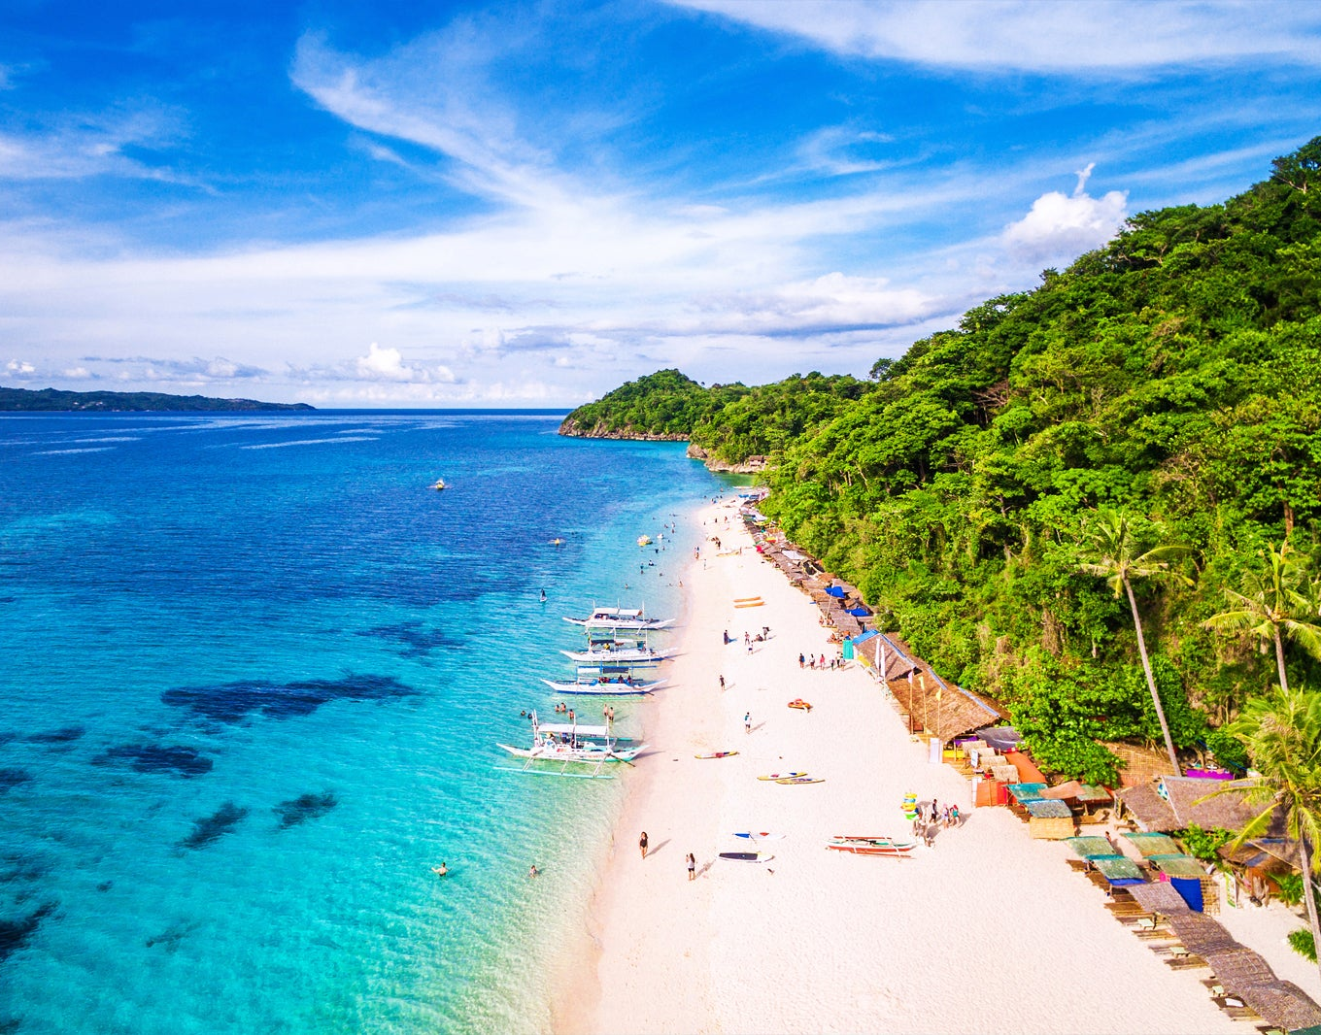

BEST BEACHES
IN THE WORLD
2022 EDITION

Slide 2
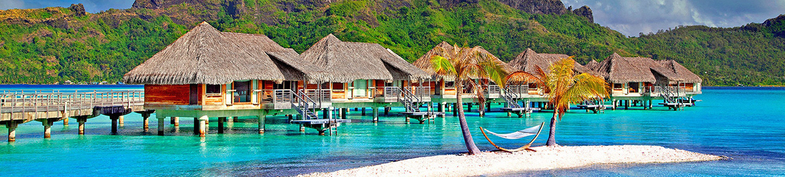
LOOKING FOR THE BEST BEACHES?
Let’s dive into our rundown of the world's best beaches.

Slide 3
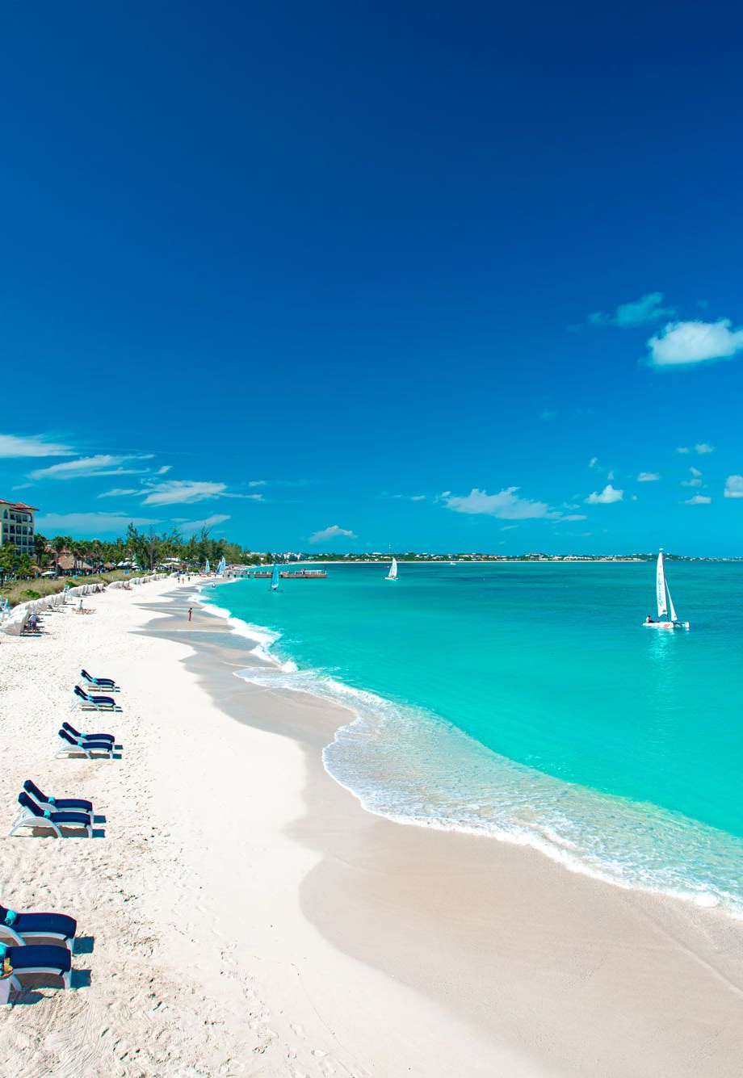
Grace Bay
Turks and Caicos
The 4.8 km long beach is located on the northeast coast of the island of Providenciales and is home to an extensive barrier reef, situated about a mile (1.6 km) offshore. The reef protects Grace Bay from the ocean swells of the Atlantic, helping to keep the water calm and safe, and providing endless opportunities for snorkeling, kiteboarding, kayaking, and more.
Grace Bay Beach is where you find nearly all of the large and luxury resorts on Providenciales, as well as world-class dining, entertainment, and nightlife. A huge perk of Grace Bay is that the remote island of Providenciales is less than a 2-hour flight from Miami and a little over 3 hours from New York.

Slide 4
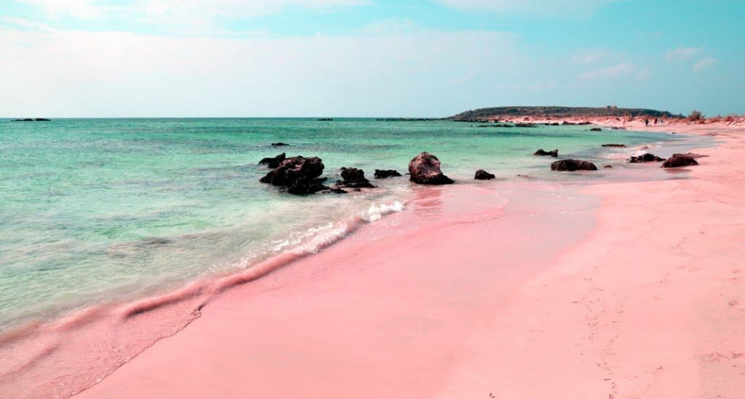
Pink Sands Beach
Bahamas
Found on Harbor Island, one of the smaller islands of the Bahamas, Pink Sands Beach is aptly named for its 5 km long stretch of unbelievable soft pink sand.
The pink color makes this beach one of the most unusual and impressive beaches in the world. The light rose color is a result of foraminifera — a marine animal — and its red shell, which crushes and mixes with the white sand. Located along the island's eastern Atlantic Ocean side, the beach is a highly desirable vacation destination, offering numerous activities, great beaches, and luxury resorts.

Slide 5
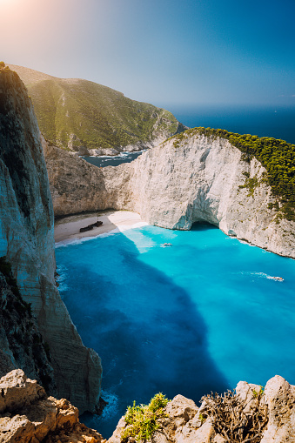
Navagio Beach (Shipwreck Cove)
Greece
Navagio Beach, also known as Shipwreck Cove, on the Greek Island of Zakynthos (Zante) off the southwest coast of Greece is not just a beach but also the site of a world-famous shipwreck.
The stunning Greek beach is surrounded by brilliant blue ocean water on one side and towering limestone cliffs on its 3 other sides. Right in the middle sits the rusting remains of an old shipwreck: the MV Panayiotis, after washing up on the shores of the bay in October 1980.

Slide 6
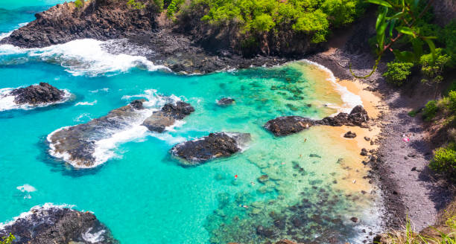
Baia Dos Porcos
Brazil
One of the smallest beaches on this list, Baía dos Porcos has just 100 m of golden sands divided by huge dark volcanic rocks that rise up on all sides.
This rock-studded beach is home to white sands and unbelievably turquoise waters, including many pools with colorful fish due to the shelter provided by the high walls of black stone. Visitors also find sensational panoramas of the Morro Dois Irmãos and calm, gentle waters for swimming.

Slide 7
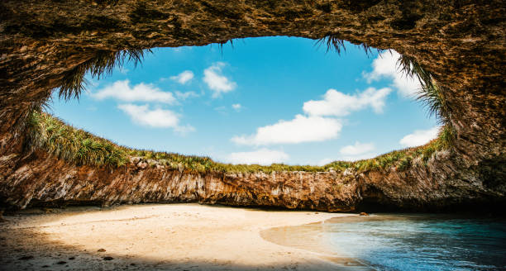
Playa del Amor (Hidden Beach)
Isla Marietas, Mexico
A true one-of-a-kind beach, Playa del Amor, commonly known as the Hidden Beach, seems as if it came straight out of a fantasy novel.
Located on one of the Marieta Islands, 22 nautical miles west of Puerto Vallarta at the mouth of Banderas Bay, this beach is completely hidden from view until you arrive just a few feet away. Suddenly, the surface of the lush green island opens up to reveal a wide, sandy cavern with the blue waters of the Pacific rushing in.

Slide 8
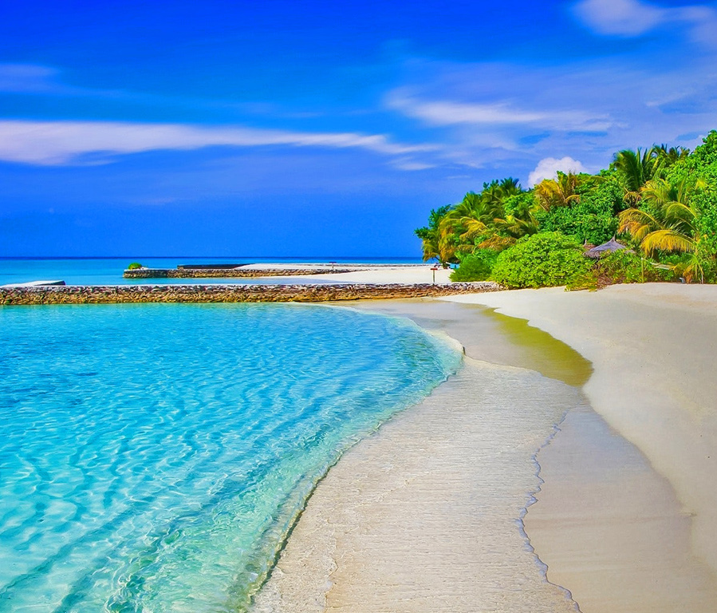
THANK YOU!
Presentor:
Trisha Anne Aguillon

